Slide 1
ESS Automation Deployment
2011.09.01
Webber Ling, Shanghai

Slide 2
Topics
Current ESS Automation Framework Structure
What is missing?
Package of solution with/without QC
Action Items

Slide 3
Current ESS Automation Framework Structure

Slide 4
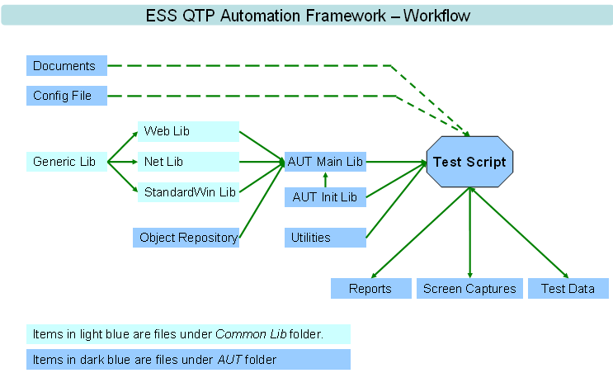
Current ESS Automation Framework Structure

Slide 5
What is missing?

Slide 6
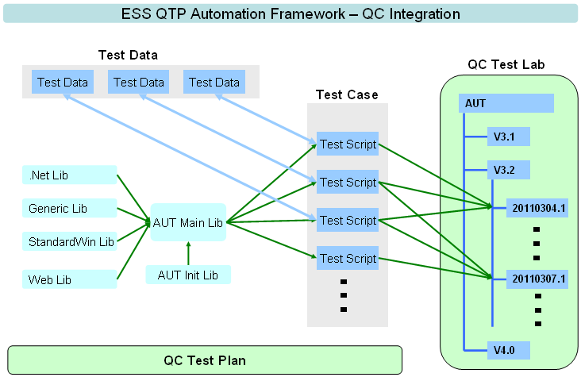
Missing what?

Slide 7
Package of solution with/without QC

Slide 8
Package of solution with/without QC
Test Execution Management
Reporting

Slide 9
Action Items

Slide 10
Action Items - Documentation
Overview of existing test execution management (Wally) – Due date 2011-09-15
Overview of existing reporting management (Wally) – Due date 2011-09-15
Document test execution deployment steps (Wally/Alice) – Due date???
Document reporting deployment steps (Wally/Alice) – Due date???
Document Test Case (Manual/Automated) life cycle (Borlla & Webber) – Due date???
Review and update Web return method (Webber) – Due date 2011-09-08
Review and document ConfigID script generation steps (Jie & Webber)– Due date 2011-09-08

Slide 11

www.mercer.com.au

